Slide 1
Decentralized Distribution
Personalized Experience using Blockchain/Swarm
October, 25th 2018
Prague
ATPCO – Airline Tariff Publishing Company
Industry NDC Exchange Platform | Proprietary & Confidential | © ATPCO 2018

Slide 2
NDC Exchange – Community Marketplace
Airline
Seller
NDC Exchange
Airline
Seller
Consumer
Airline
Seller
Industry NDC Exchange Platform | Proprietary & Confidential | © SITA and ATPCO 2018
Notes:
NDC2015.2 and NDC2017.2: AirShoppingRS/DataLists/MediaList/Media/MediaLink and AirShoppingRS/OffersGroup/AirlineOffers/Offer/OfferItem/Service/ServiceRef
NDC2018.2: AirShoppingRS/Response/DataLists/MediaList/Media and AirShoppingRS/Response/OffersGroup/CarrierOffers/Offer/OfferItem/Service/ServiceRefID
OA_5.6.1: FareSearchRS/InfoGroup/MarketingData/MediaContent/MediaLinks/Link
OTA_2010B: OTA_AirLowFareSearchRS/PricedItineraries/PricedItinerary/AirItinerary/OriginDestinationOptions/OriginDestinationOption/FlightSegment/MarketingCabin/Meal

Slide 3
NDC Exchange – Traveler Profile Decentralized
3. Lookup Airline
Public Key
Airline
Seller
NDC Exchange
1. Public Key
5. Encrypted Profile
2. Public Key
Consumer
6. Decrypt Profile
With Private Key
Airline
Seller
Airline
Seller
Swarm
Traveler
Profile
4. Airline Public Key + Consumer Public Key.
Returns encrypted Profile data
Industry NDC Exchange Platform | Proprietary & Confidential | © SITA and ATPCO 2018
Notes:
NDC2015.2 and NDC2017.2: AirShoppingRS/DataLists/MediaList/Media/MediaLink and AirShoppingRS/OffersGroup/AirlineOffers/Offer/OfferItem/Service/ServiceRef
NDC2018.2: AirShoppingRS/Response/DataLists/MediaList/Media and AirShoppingRS/Response/OffersGroup/CarrierOffers/Offer/OfferItem/Service/ServiceRefID
OA_5.6.1: FareSearchRS/InfoGroup/MarketingData/MediaContent/MediaLinks/Link
OTA_2010B: OTA_AirLowFareSearchRS/PricedItineraries/PricedItinerary/AirItinerary/OriginDestinationOptions/OriginDestinationOption/FlightSegment/MarketingCabin/Meal

Slide 4
NDC Exchange with Blockchain
Airline
Seller
NDC Exchange
Consumer
Airline
Seller
Airline
Seller
Swarm
Write during RS
Traveler
Profile
Read during RQ
Industry NDC Exchange Platform | Proprietary & Confidential | © SITA and ATPCO 2018
Notes:
NDC2015.2 and NDC2017.2: AirShoppingRS/DataLists/MediaList/Media/MediaLink and AirShoppingRS/OffersGroup/AirlineOffers/Offer/OfferItem/Service/ServiceRef
NDC2018.2: AirShoppingRS/Response/DataLists/MediaList/Media and AirShoppingRS/Response/OffersGroup/CarrierOffers/Offer/OfferItem/Service/ServiceRefID
OA_5.6.1: FareSearchRS/InfoGroup/MarketingData/MediaContent/MediaLinks/Link
OTA_2010B: OTA_AirLowFareSearchRS/PricedItineraries/PricedItinerary/AirItinerary/OriginDestinationOptions/OriginDestinationOption/FlightSegment/MarketingCabin/Meal

Slide 5





Key Benefits
Consumer driven data access
Decentralized distributed storage where a user decides who and what data is accessible.
Sellers offer a differentiated experience
Be a differentiator in conducting business differently.
Personalized Airlines Offers Know more about your potential traveler in order to give them what is relevant for them.
Industry NDC Exchange Platform | Proprietary & Confidential | © SITA and ATPCO 2018

Slide 6
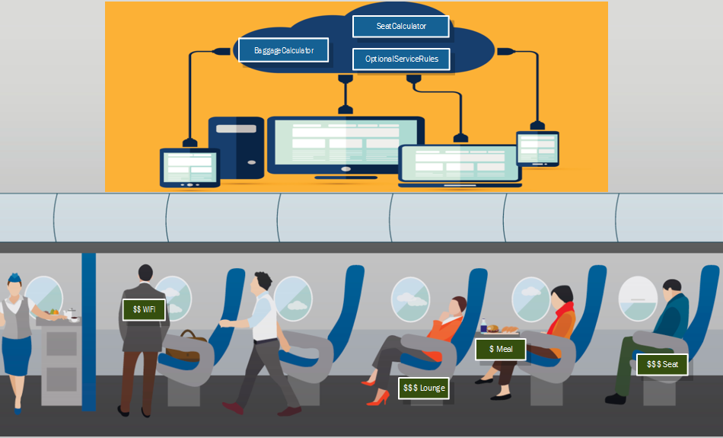
Questions
Industry NDC Exchange Platform | Proprietary & Confidential | © ATPCO 2018

